Slide 1
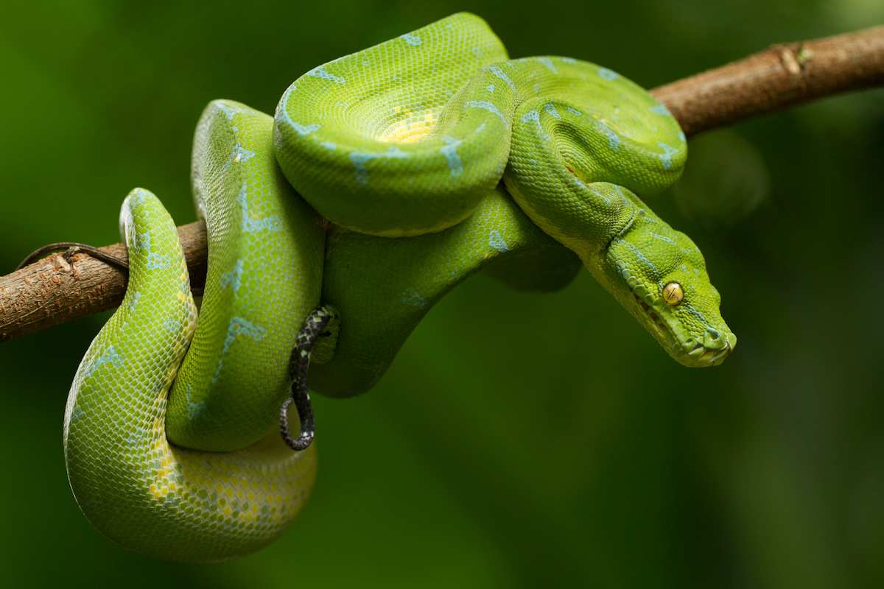
Python packages for Data Science
Chandra Sarkar Source slides - Trevor Faske, Thomas Parchman

Slide 2


Base Python
Python with libraries

Slide 3
Contents
Useful libraries and applications of python
Module: python4_pandas_primer.md
numpy
pandas
Ask anything!!!
python4_pandas_practice.md & answers

Slide 4
Ways to use python
Interactive through terminal
Scripting using text editor
IDE (Integrated Development Environment)
PyCharm
Spyder
RStudio
Anaconda / miniconda
Jupyter notebooks
Environments and repositories

Slide 5

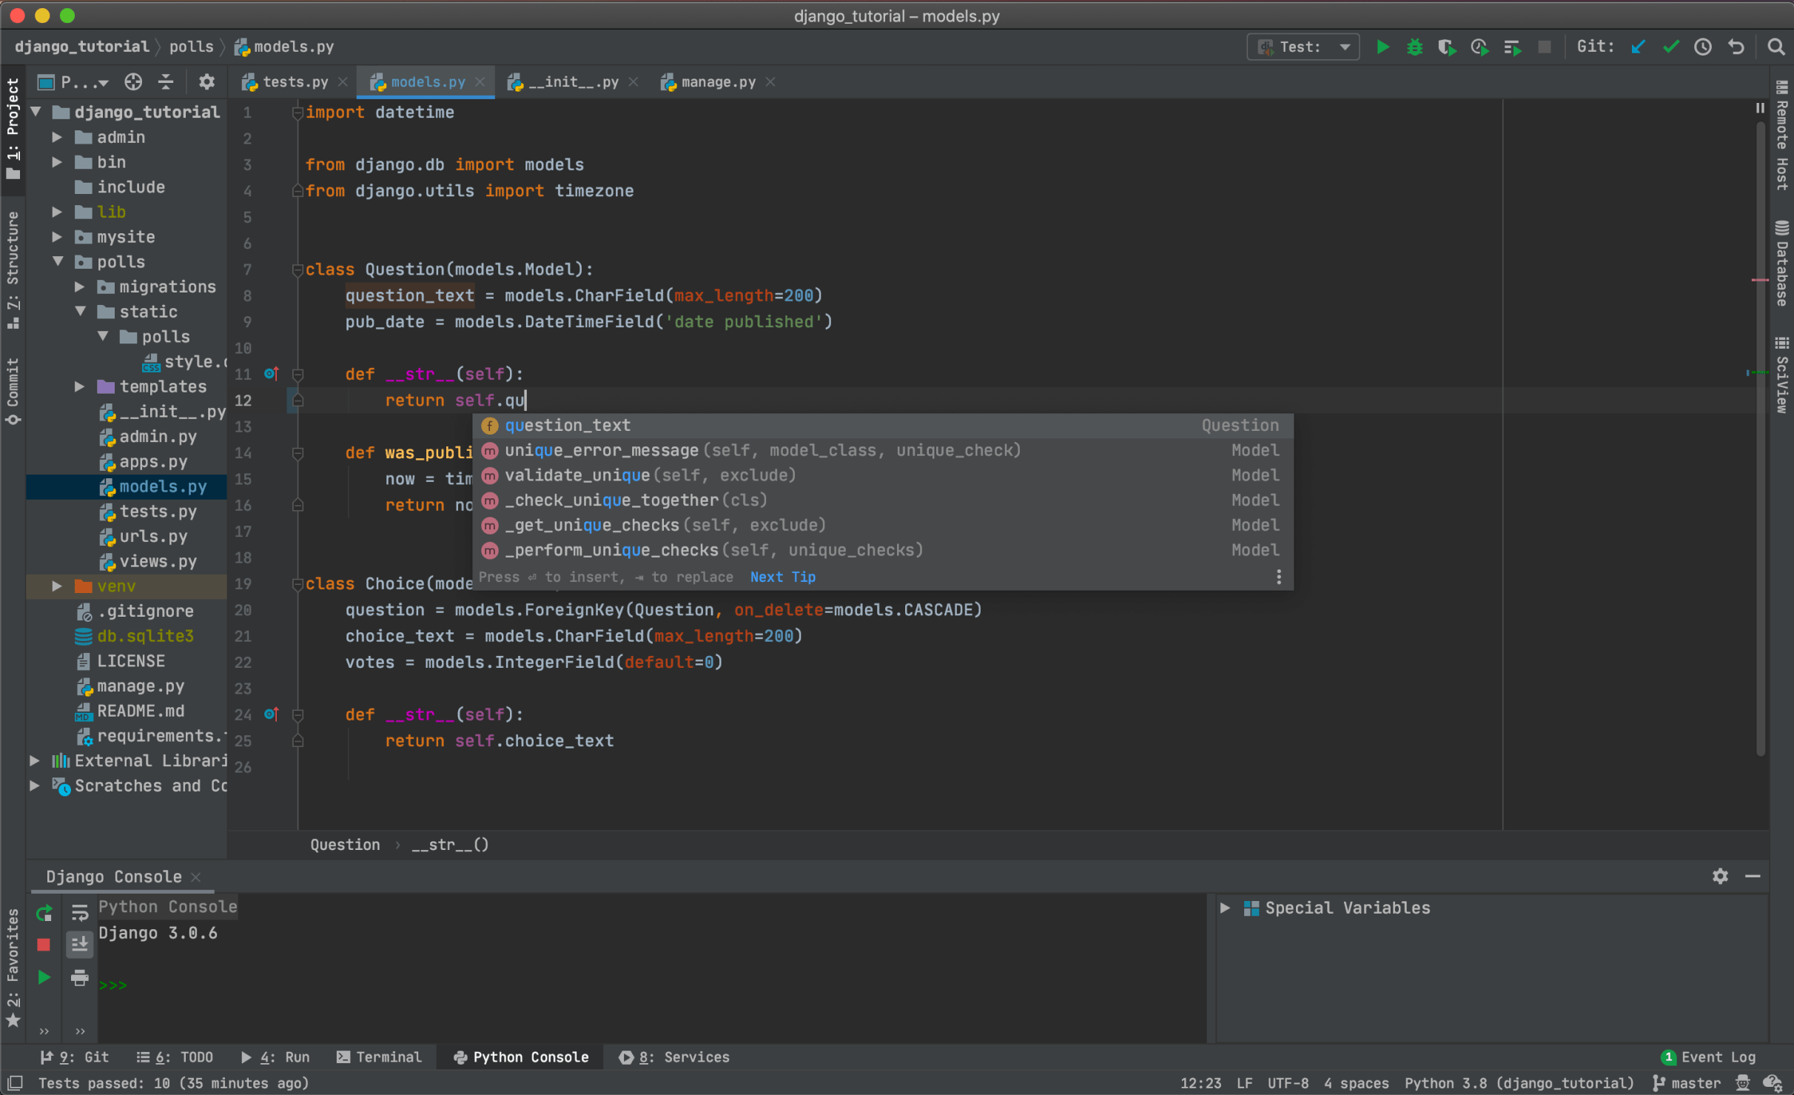
PyCharm

Slide 6

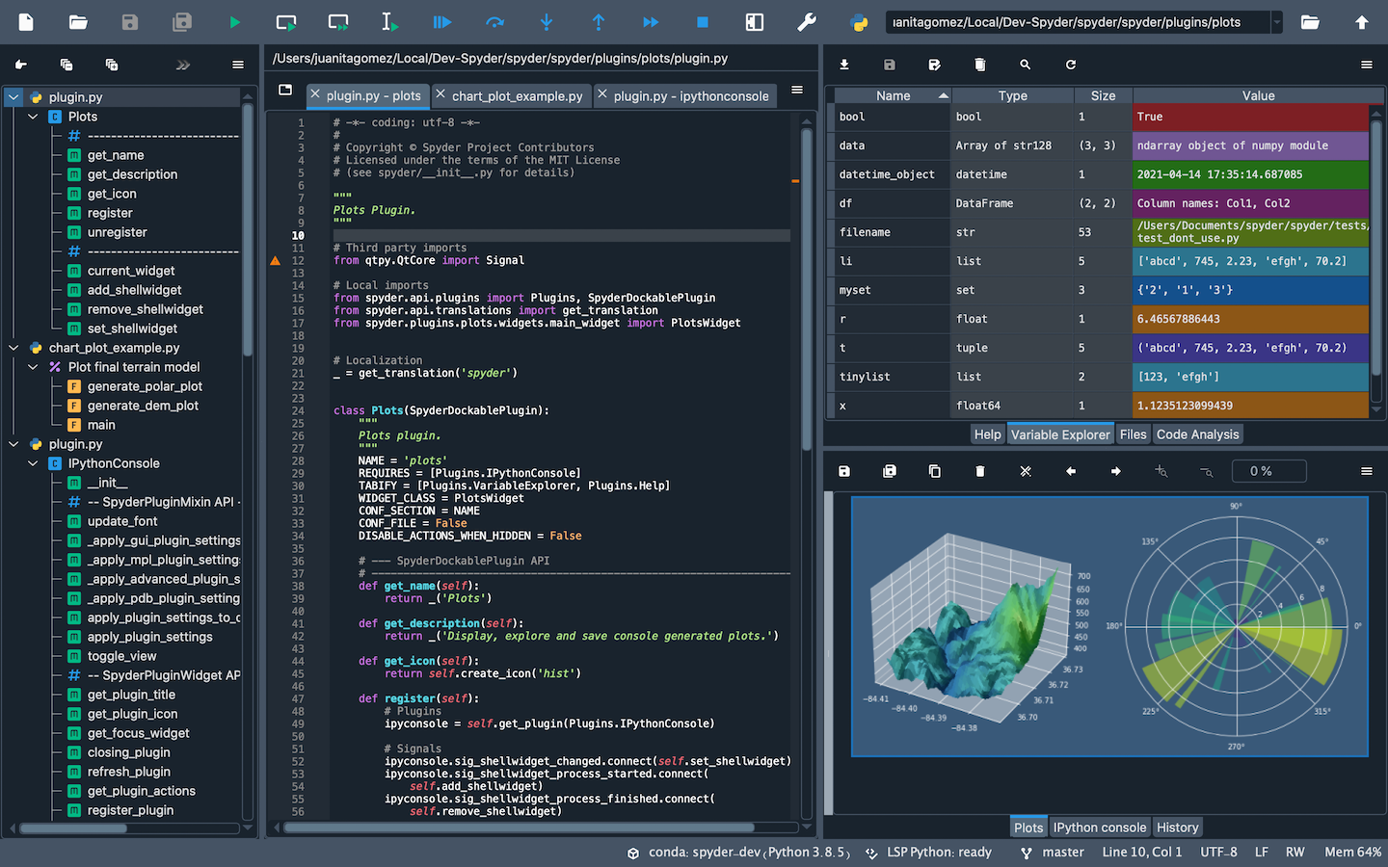
Spyder

Slide 7

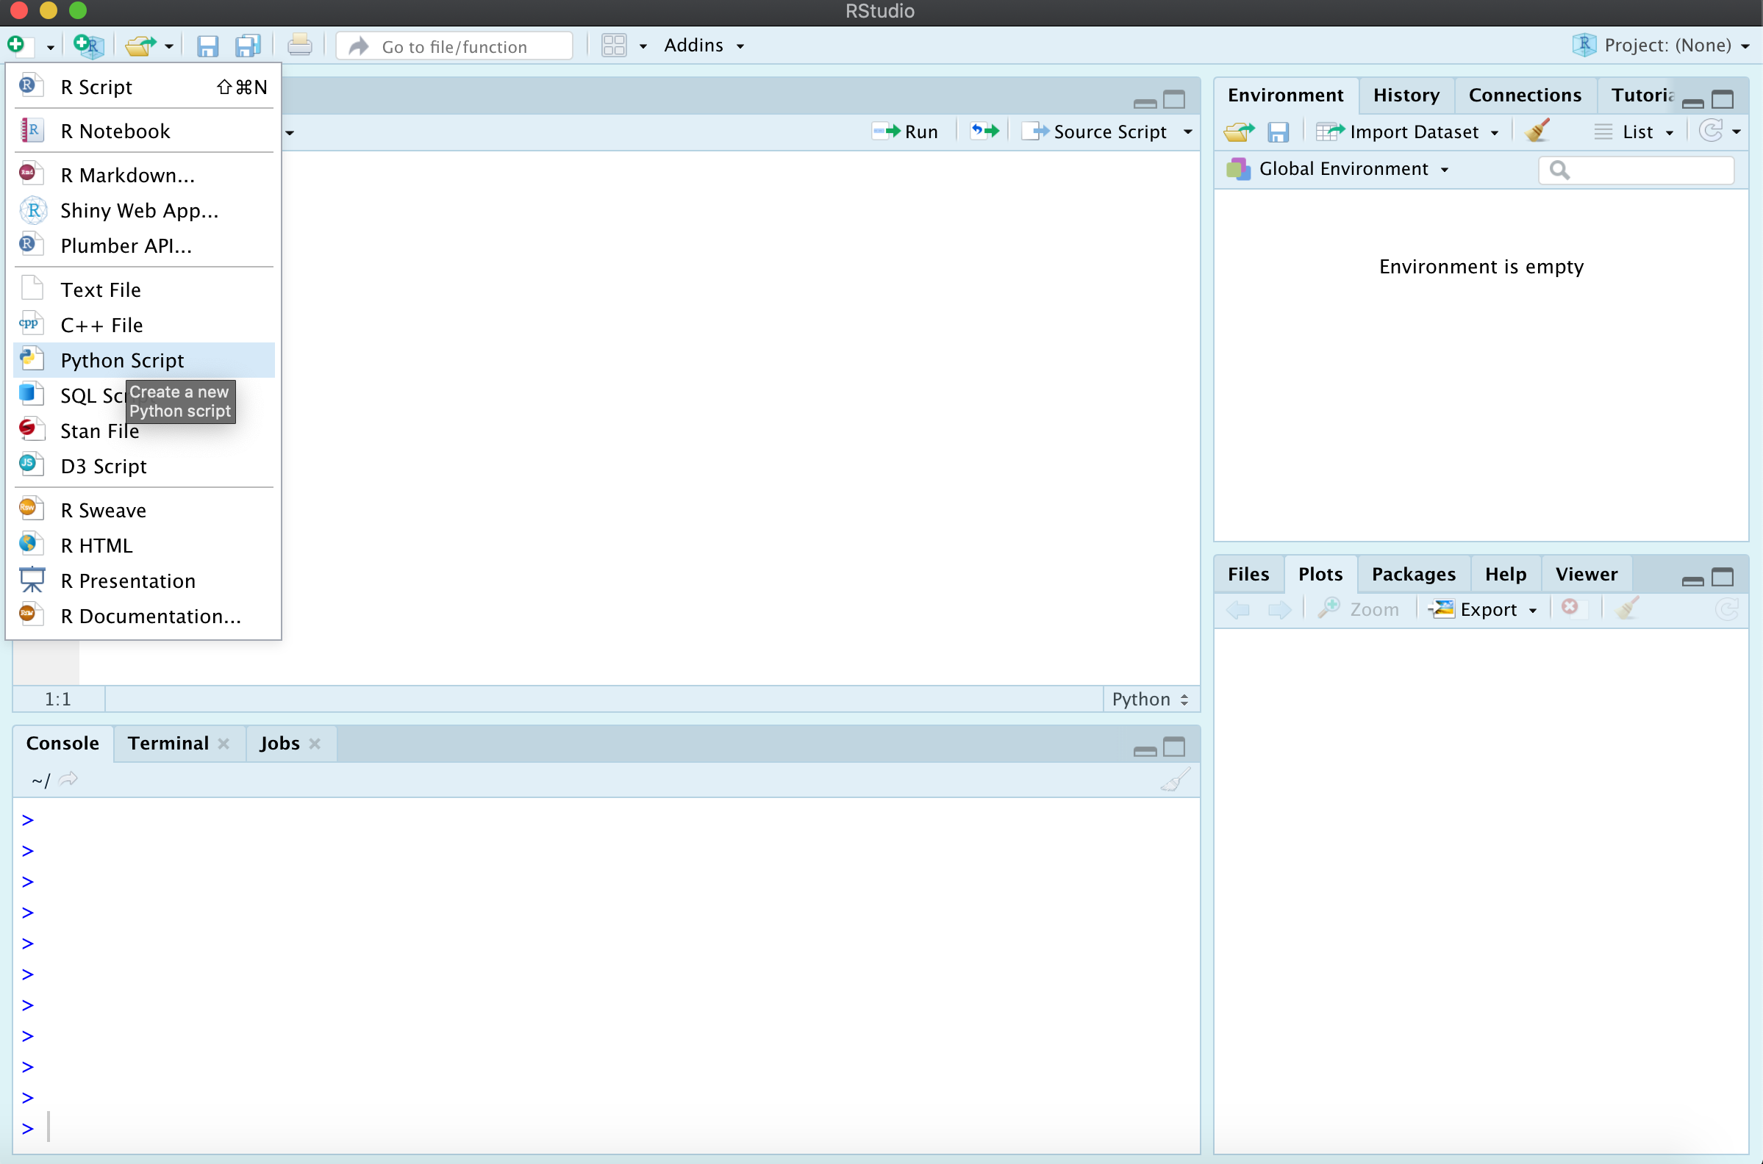
RStudio

Slide 8
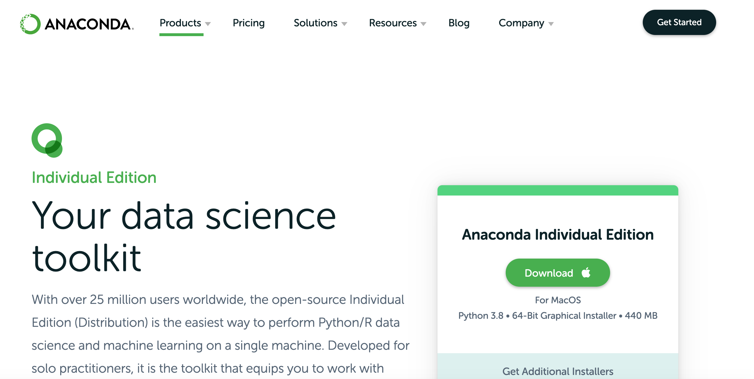
Anaconda

Slide 9
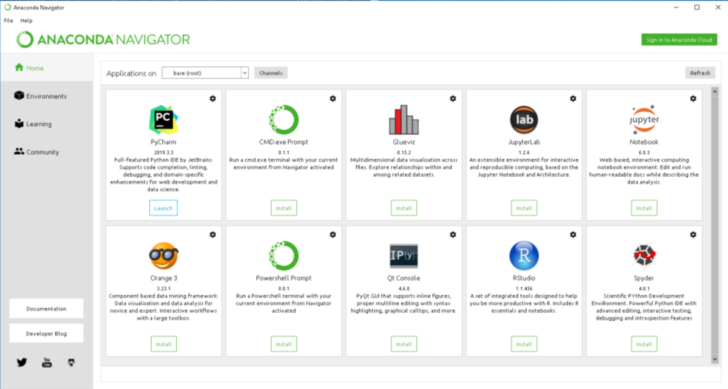

Slide 10
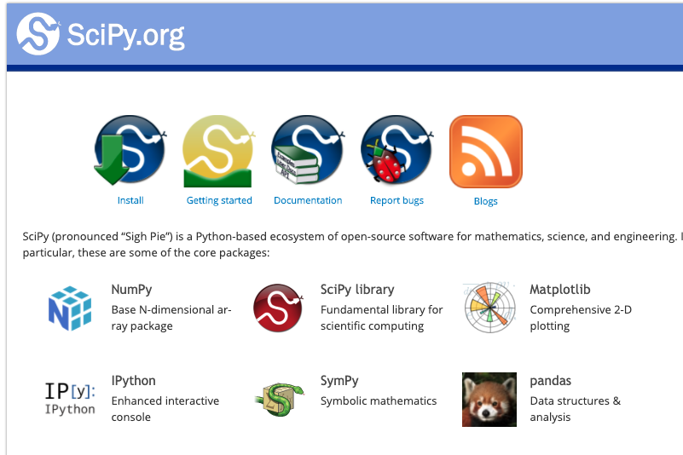
Python libraries
(137,000 estimated)

Slide 11
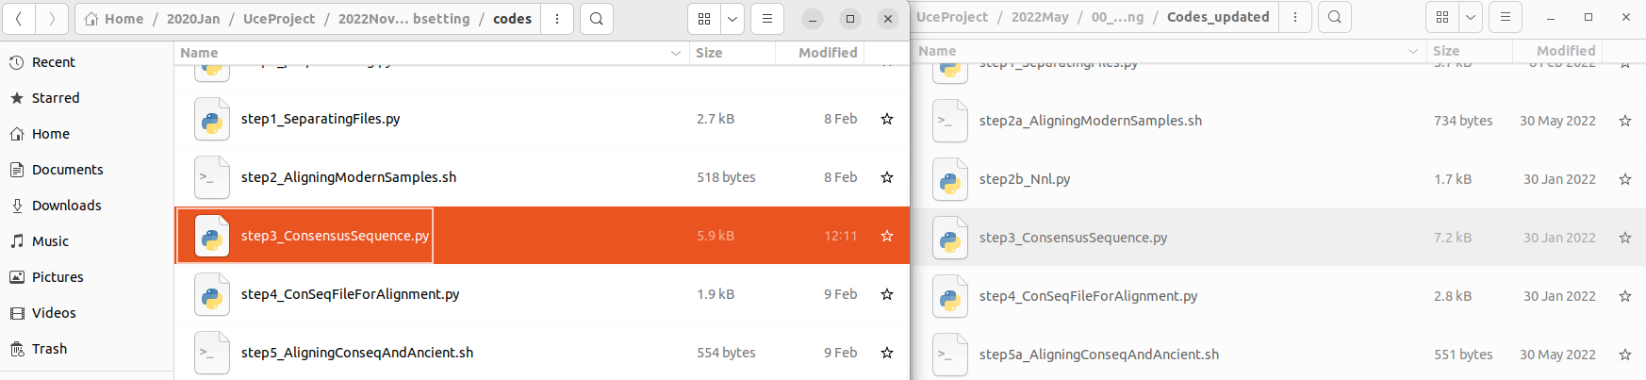
Why use Python libraries and modules

Slide 12
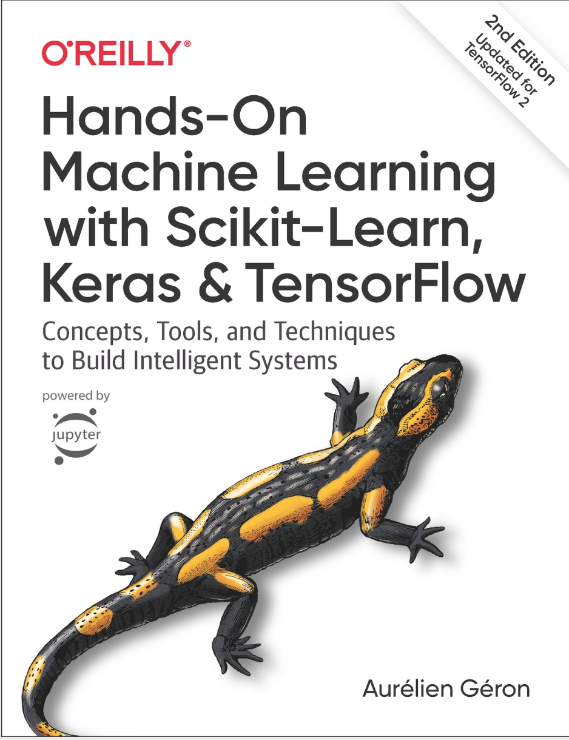

Machine Learning
Tensor Flow
Keras
Scikit-learn

Slide 13
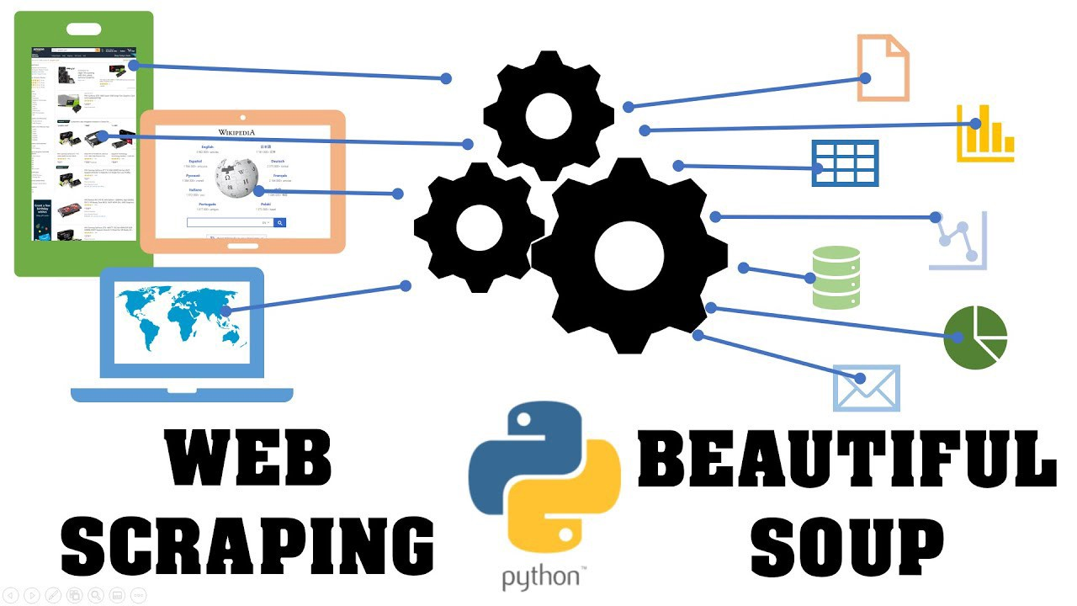

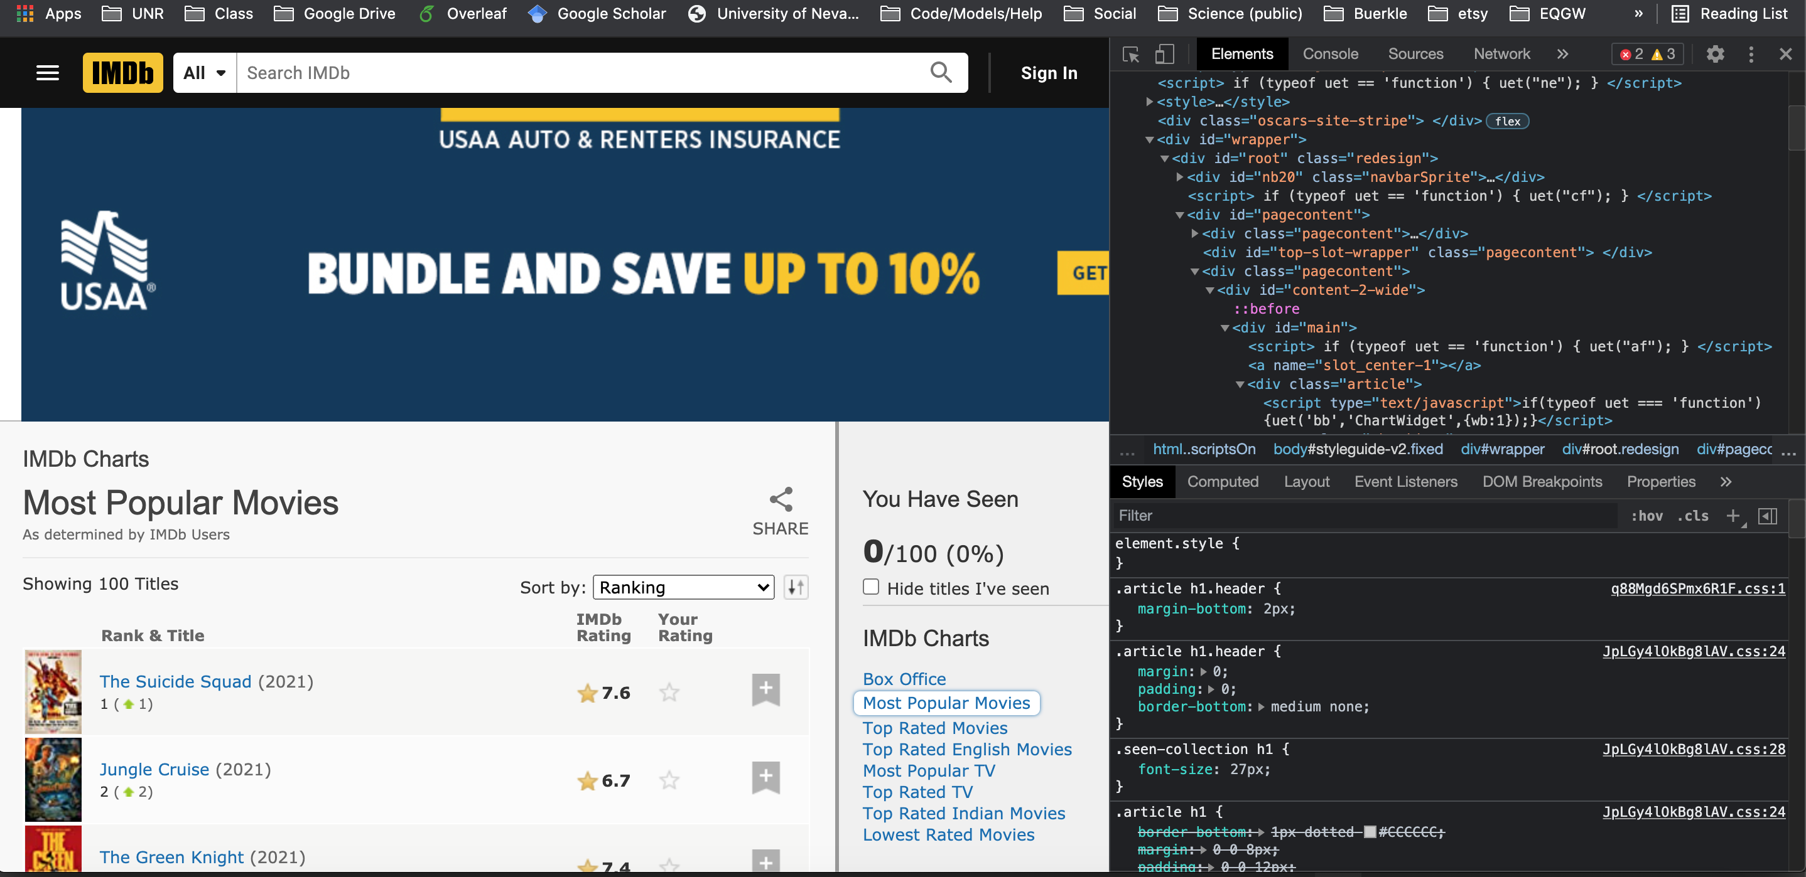
Web data scrapping

Slide 14
Python4_pandas_primer.md
First, any additional python use questions?
Next, primer walk through. Follow along in interactive python

Slide 15
Installing python libraries
From the terminal / command line:
$ pip3 install package_name
$ pip3 install numpy
$ pip3 install pandas
$ pip3 install matplotlib
If you get a permissions error:
$ pip3 install --user package_name

Slide 16
Import and using libraries
Top of script in python
import os,re,sys (import multiple libraries in single line)
import numpy as np (import package as alias)
from numpy import DataFrame (import only specific function)
Common aliases universally used
import numpy as np
import pandas as pd
import matplotlib.pyplot as plt

